Slide 1
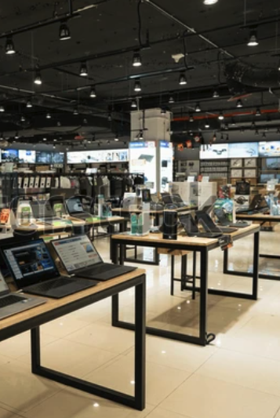

Electronic Product Adds-on Up-Selling
SUPER
ELECTRONIC
ELECTRONIC STORE
November 2024

Slide 2

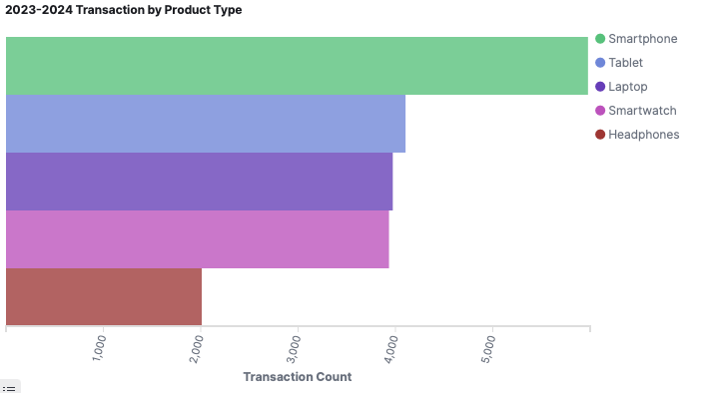
Background & Objectives
SUPER
ELECTRONIC
ELECTRONIC STORE
The objective of this report is to provide insight from analysis and visualization taken from dataset related to adds-on item sale.
Background underlined this report creation is trade barrier policy enforced by government to banned several smartphone brand to sold in Indonesia.
Output will be focused in incensement of adds-on items upselling
Dataset used are electronic transaction dataset, ranged from Sep 2023 – Sep 2024. Containing 20,000 transactions.

Slide 3
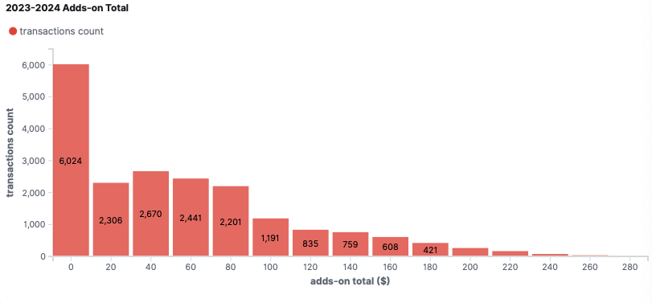
Adds-on Purchase
SUPER
ELECTRONIC
ELECTRONIC STORE
In rounding to 20 US dollars, the purchase amount of add-on items in each transaction has quite wide variations, starting from $20 to $260 in each transaction.
The most common mode is purchasing add-on products at a price of $20 to $80 which accounts for approximately 50% of add-on product sales transactions.
The insight that can be concluded from this bar plot is that there are still around 6,000 electronic product purchases (more than 25%) who do not purchase add-on products, or make purchases under $20. So this segment needs to be focused on for up-selling.
Note: we use US Dollar since the units follow the US Dollar exchange rate, referring to the majority of imported products or CBU

Slide 4
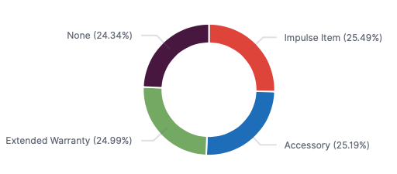
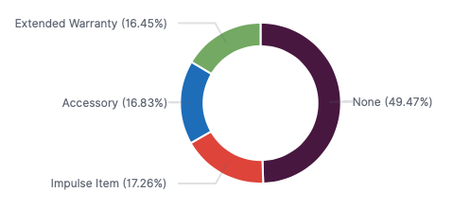
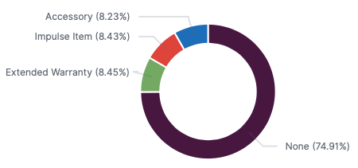
Adds-on Item Category
SUPER
ELECTRONIC
ELECTRONIC STORE
1st Item
2nd Item
3rd Item
We have 3 adds-on item category:
Extended Warranty,
Accessory and
Impulse Item.
Maximum adds on items purchased in every transaction are 3 items, the pie charts above show the proportion of each category as 1st, 2nd, and 3rd purchased items.
Taken from this conditions, we can conclude that the more we can sold adds-on item in every transaction, the more 2nd and 3rd items bought by costumer

Slide 5
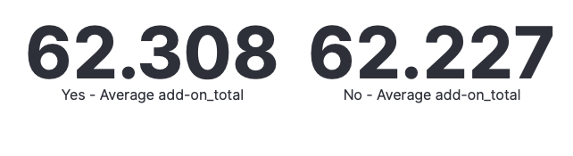
Loyalty Membership
SUPER
ELECTRONIC
ELECTRONIC STORE
Loyalty Member vs Non-Loyalty Member
The average purchase of add-on items from consumers who have loyalty members and those who do not, shows no significant difference. So that the consumer segment that will later become the target of the campaign or up-selling promotion strategy that will be carried out is not limited to having or not having a membership. The up-selling strategy needs to be applied to all consumers and potential consumers.

Slide 6
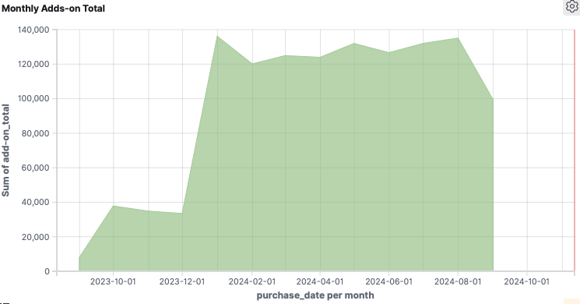
Monthly Sale
SUPER
ELECTRONIC
ELECTRONIC STORE
The peak of adds-on item purchase is Jan 2024, related to New Year Season
Followed by May 2024 which in period of Idul Fitri
Seasonal event in Aug 2024, are National Independent day, which also contribute high selling amount.
Nearest upcoming seasonal event will occur in next 2 month as 2025 New Year and Christmas seasonal event

Slide 7
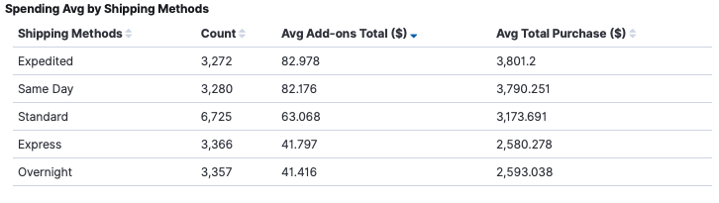
Shopping Behavior
SUPER
ELECTRONIC
ELECTRONIC STORE
From these five shipping methods, the average nominal value spent is highest for the Express and Overnight methods. These methods tend to excel in either speed or price, usually chosen by consumers who are price-sensitive and critical in weighing purchasing decisions. The "price-sensitive" character is also shown by purchases of products with low value and low-cost add-ons. Meanwhile, the Same Day shipping method is typically chosen by consumers with impulsive characteristics, including those inclined to buy item add-ons. The Expedited and Standard shipping methods allow consumers to make non-urgent purchases that don't require electronics. This allows consumers to add more items as add-ons, enabling them to buy multiple items simultaneously, even if shipping takes longer. The target segment for this analysis focuses on users of the three shipping methods: Same Day, Standard, and Expedited.
The second highlighted consumer buying habit is that the higher the electronic product value purchased, the more add-on items are bought. This finding suggests a high probability of additional purchases, which are also more likely for consumers who purchase high-value electronics with a high nominal value.
Based on customer preferences for Shipping Methods, which can be described as follows:
Same Day is the fastest and most premium option, typically arriving on the same day.
Overnight is a fast shipping option arriving the next day, considered premium.
Express offers good speed (1–2 days) at a lower price than Overnight.
Expedited takes around 2–3 days, usually chosen for medium-priced items.
Standard is the most economical shipping option, taking the longest (3–7 days).

Slide 8
Recommendation
SUPER
ELECTRONIC
ELECTRONIC STORE
Based on the analysis of add-on purchases, we recommend the following strategies. These can serve as a basis for more relevant planning by the marketing and related departments:
Up-Selling Add-Ons: Emphasize add-on offers through bundling with electronic products and targeted marketing to boost familiarity and encourage repeat purchases.
Target Segmentation: Segment consumers, especially by shipping method, to tailor marketing efforts efficiently and reduce campaign costs.
Seasonal Timing: Identify "golden seasons" for optimal marketing impact and sustainable revenue generation.
These recommendations provide a foundation for planning effective campaigns and up-selling strategies in response to PETSL factors, with further collaboration needed for implementation.

Slide 9
Thankyou ☺
SUPER
ELECTRONIC
ELECTRONIC STORE

